Slide 1
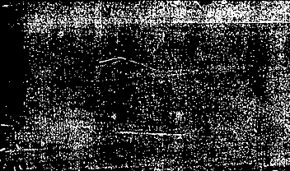
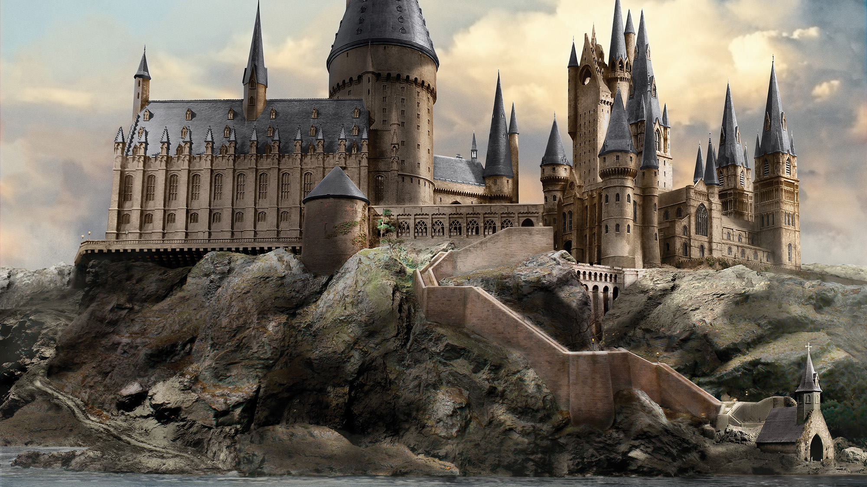

Conquer Hogwarts
Aining Liu

Slide 2

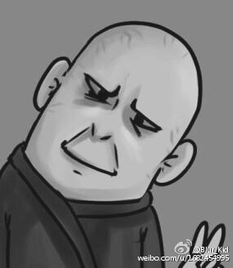
Inspiration and Concept
The movie Harry Potter
What is it like to be the bad guy？
Target player: people who are familiar with Harry Potter or people who wants to learn about Harry Potter
Highlight: Every character should correspond to a plot in the movie

Slide 3
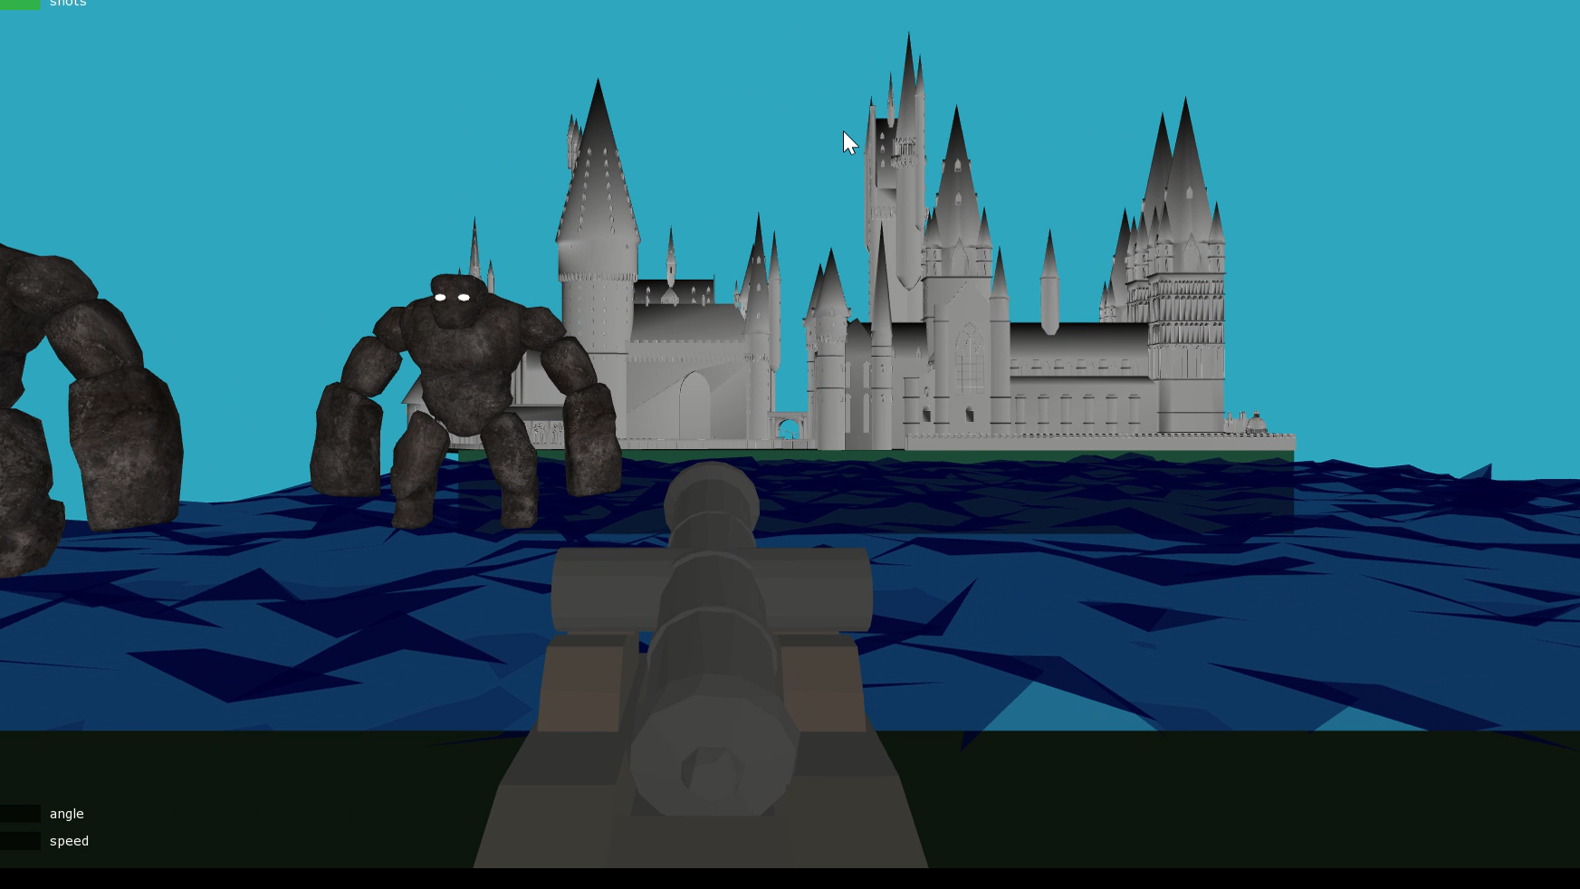
Mechanic
Simple shooting mechanic to destroy the Guardian of Hogwarts
Alter the projectile of the bullet using up/down key
Increase the speed of the bullet by pressing ‘s’

Slide 4
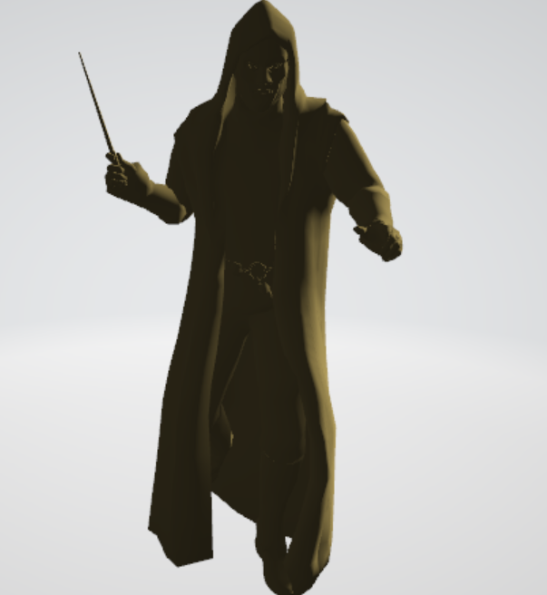
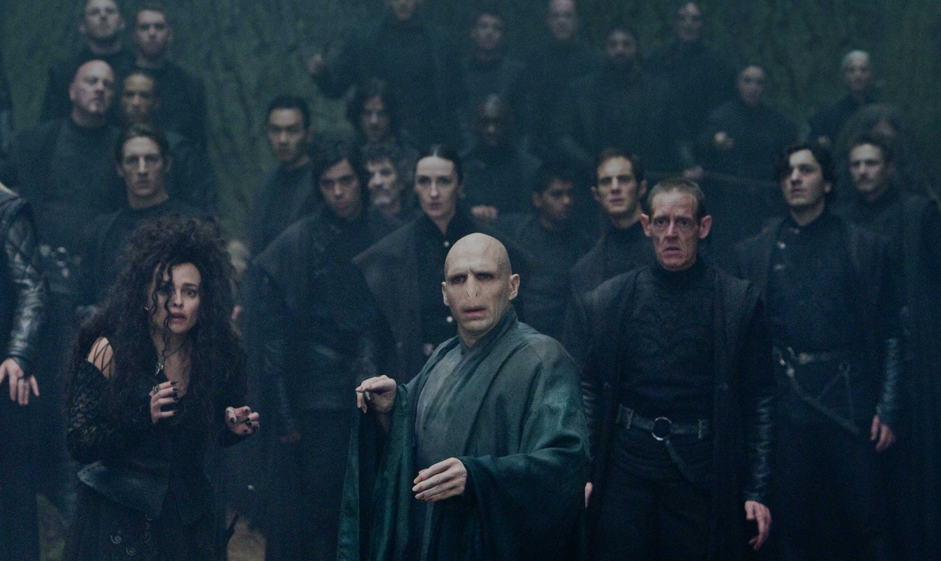
Aesthetics
Death Eater
Characters from the movie

Slide 5
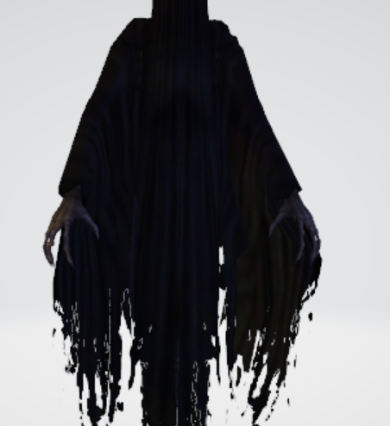
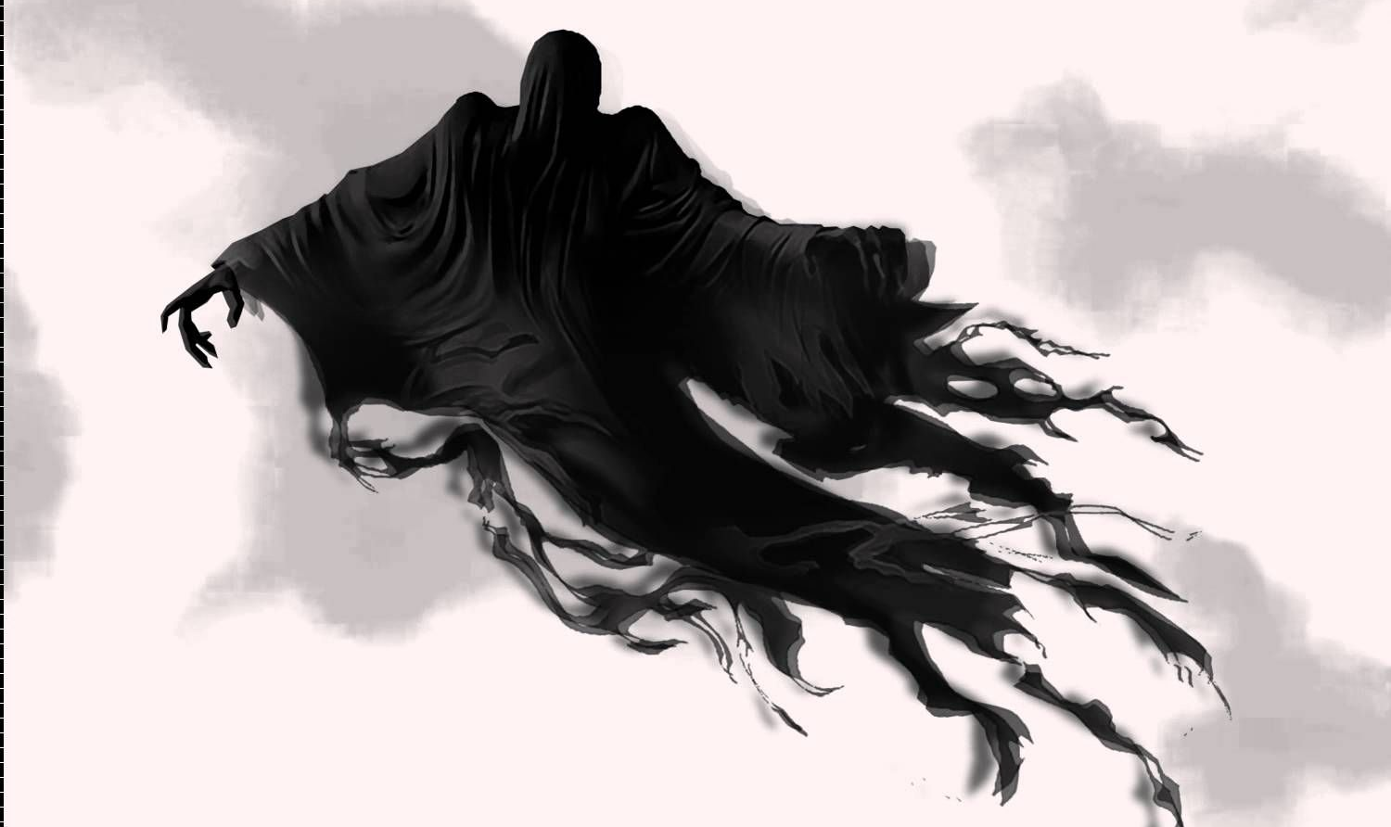
Aesthetic
Dementor
Characters from the movie

Slide 6
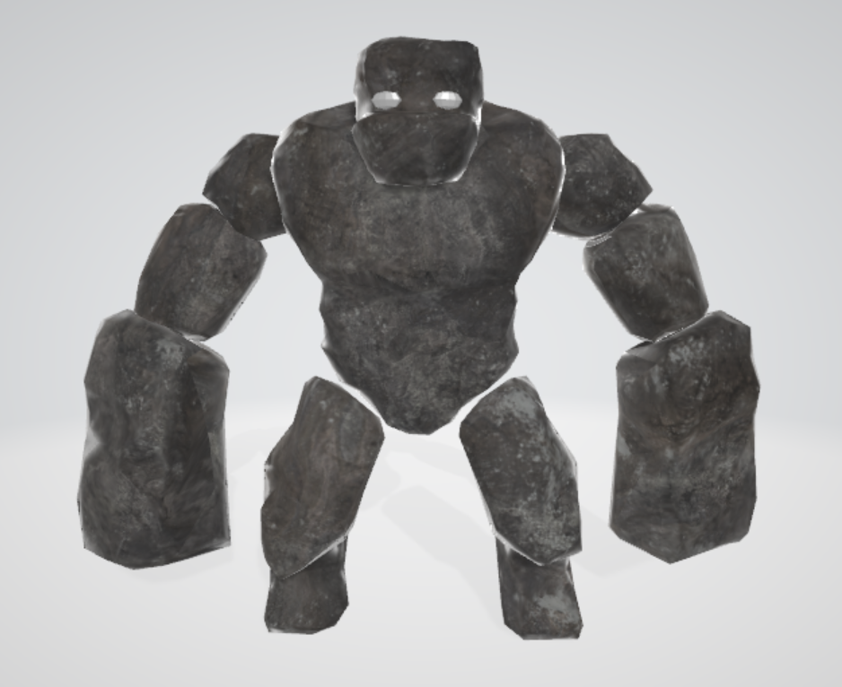
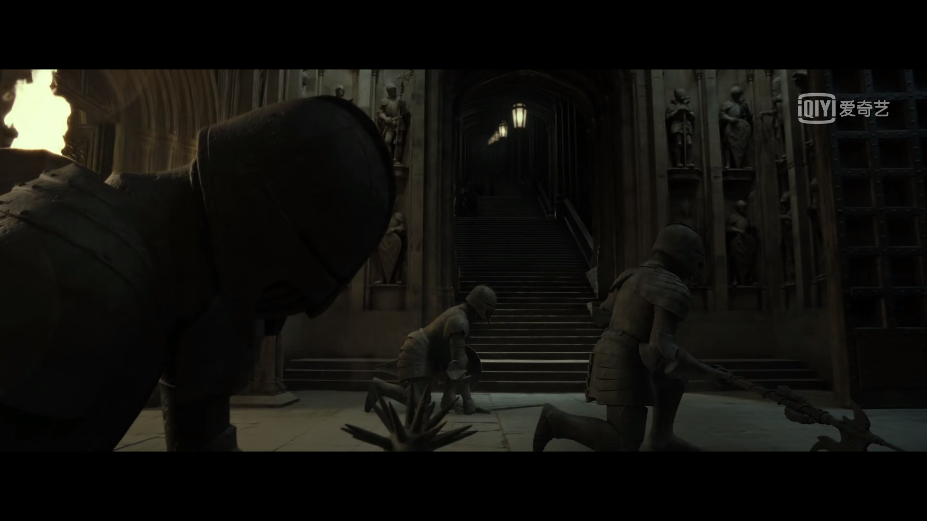
Guardian of Hogwarts
Stone statute waken by professor McGonagall in Harry Potter and the Deathly Hallows

Slide 7
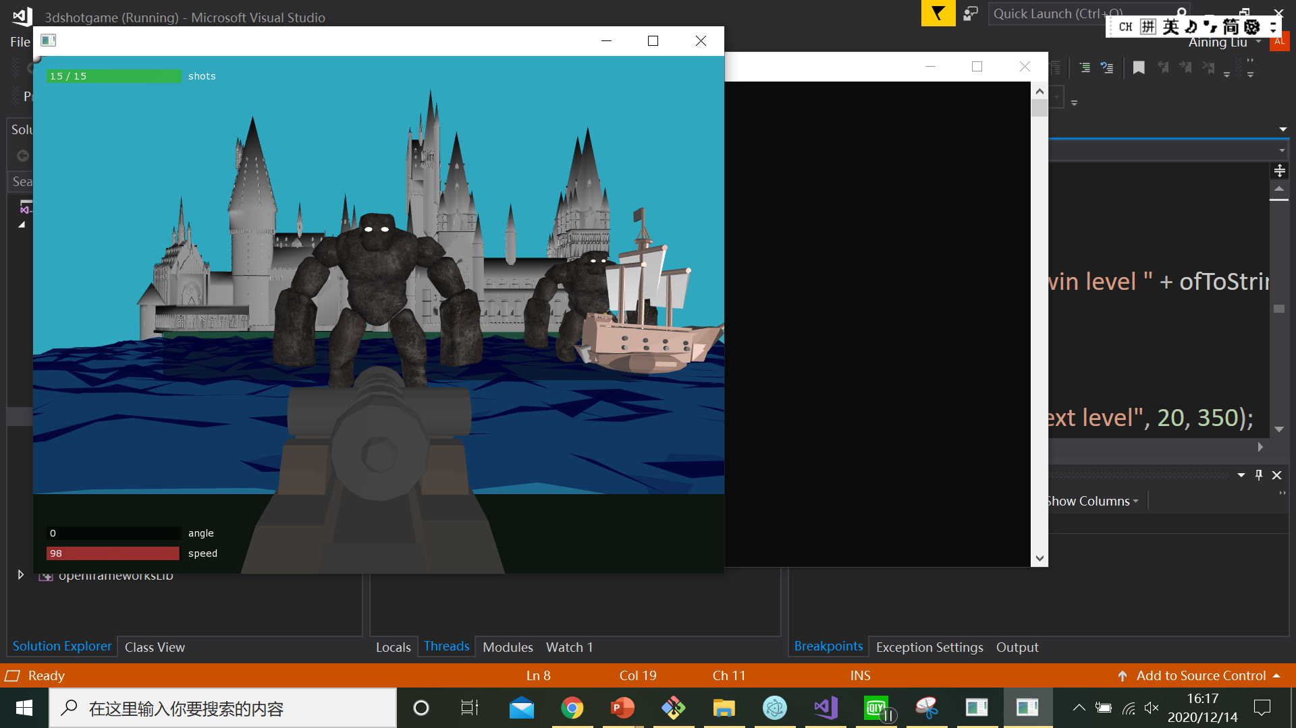
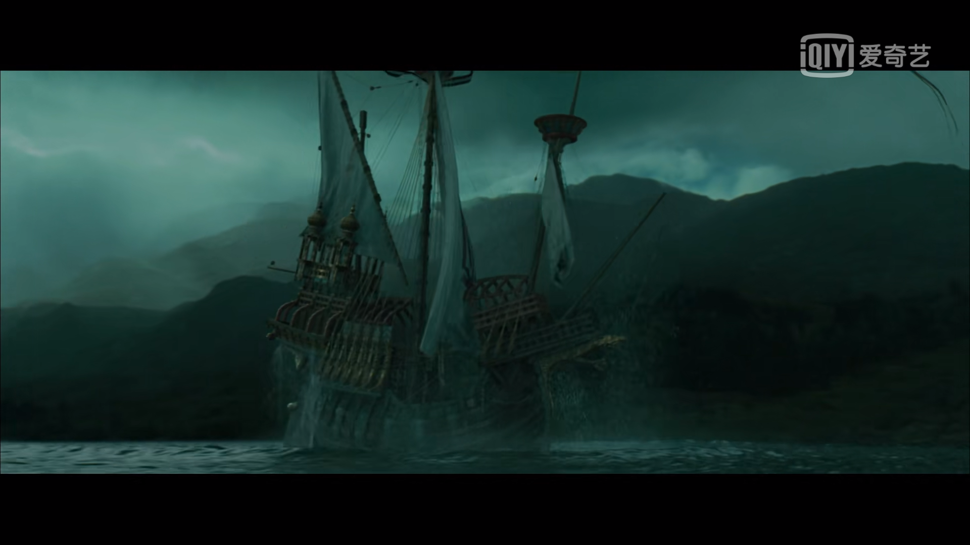
Guardian of Hogwarts
Boat from Harry Potter and the Goblet of Fire

Slide 8
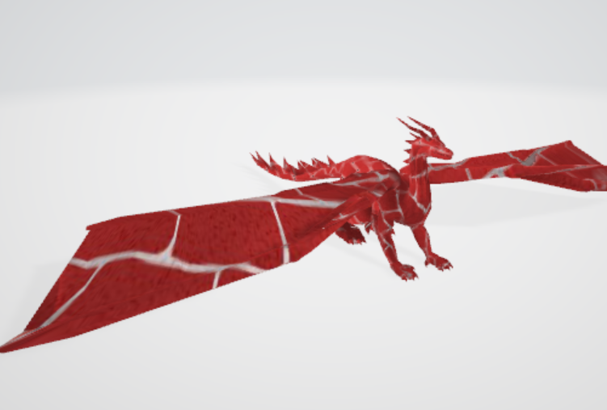
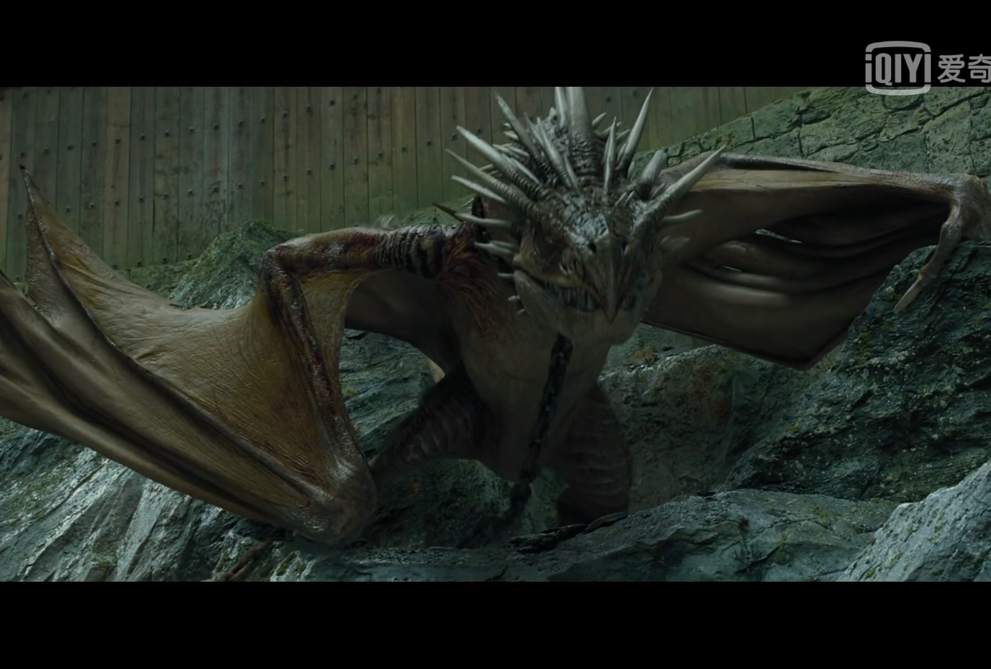
Guardian of Hogwarts
Dragon from Harry Potter and the Goblet of Fire

Slide 9
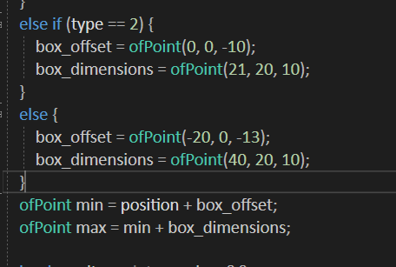
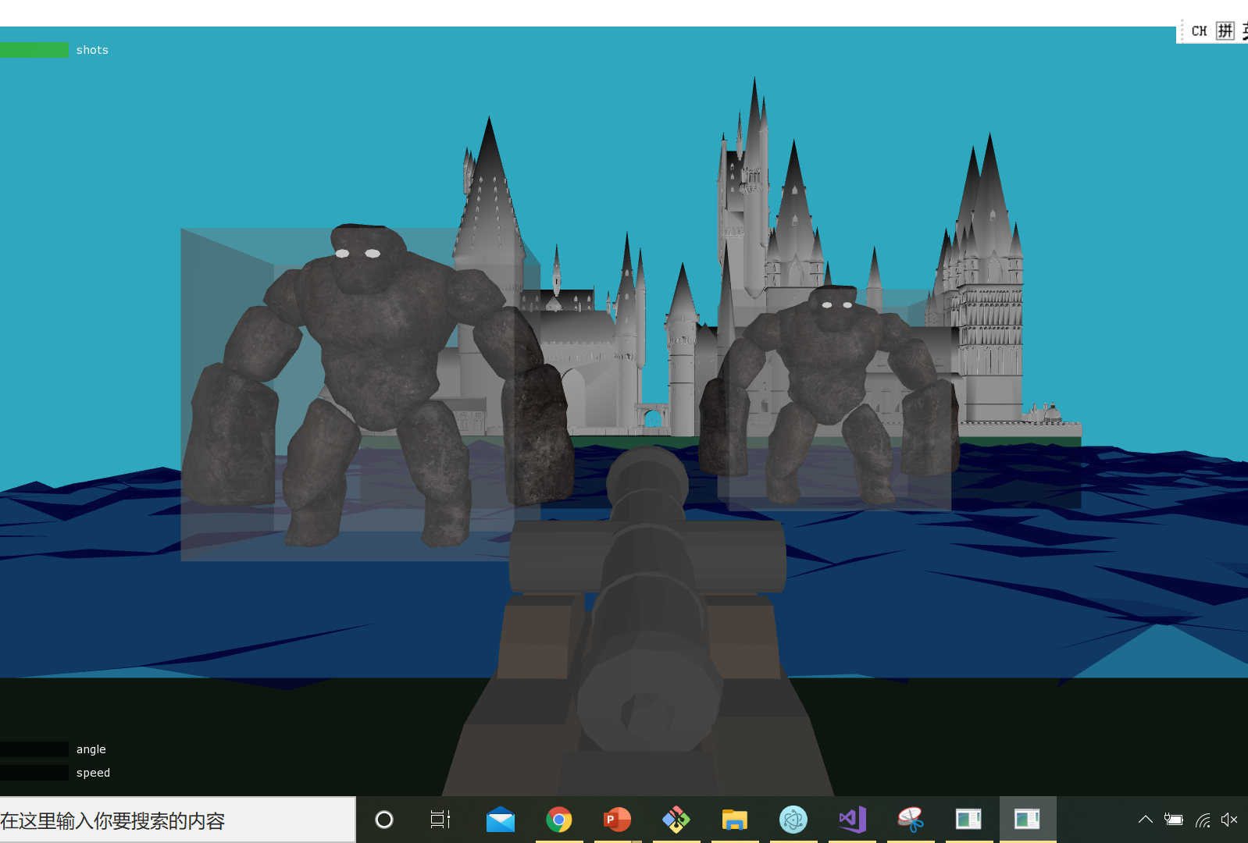
Implementation
Generate box for each guardian
Detect whether the bullet is in the box

Slide 10
Future developments
Improve background (simulate thunder like the Hogwarts Dome)
Texture the castle
More delicate animation

